Slide 1

Advisory Council to Support Grandparents Raising Grandchildren Meeting
Washington, DC
August 28-29, 2019
Day 1

Slide 2
The Agenda
Day 1 – August 28, 2019
Meeting overview, intros and orientation
Panel presentation & discussion
Public comment period
Wrap up Day 1
Day 2 – August 29, 2019
Questions from day 1
Federal programs overview
Working groups and focus area discussions
Report outs/sub-committee formation
Public comment
Next steps and adjourn

Slide 3
Council Member Introductions
In 90 seconds or less, tell us:
Your name
Where you are from (city/state)
Your connection to family grandparenting (personal, professional, both)
What core values do you believe should guide the Council’s work?
Values: basic and fundamental beliefs that guide or motivate attitudes or actions.

Slide 4
The Supporting Grandparents Raising Grandchildren Act - Overview

Slide 5
Supporting Grandparents Raising
Grandchildren Act– overview 1 of 9
Timeline
Legislation Introduced: 5/10/17
Final passage in the House: 6/13/18
Passed in the Senate: 6/21/18
Signed into Law: 7/7/18 as P.L. 115-196
First appropriation of funds: 09/2018
Current sunset: 7/7/21

Slide 6
Supporting Grandparents Raising
Grandchildren Act– overview 2 of 9
Section Titles
Sec. 1: Short Title
Sec. 2: Findings
Sec. 3: Advisory council, required activities, deliverables and public input
Sec. 4: Definitions
Notes:
We will only walk through Sections 2 and 3.

Slide 7
Supporting Grandparents Raising
Grandchildren Act– overview 3 of 9
Sec. 2. Findings
Prevalence – More than 2.5 million grandparents are primary caretakers for their grandchildren
From 2009 -2016 the incidence of parental alcohol/drug use as a contributing factor for placement of a child rose from 25.4% to 37.4%
Placement of a child with relatives is preferred when they cannot remain safely with a parent

Slide 8
Supporting Grandparents Raising
Grandchildren Act– overview 4 of 9
Sec 2. Findings (cont)
Grandparents’ lives are enhanced by caring for grandchildren
Providing full-time care may result in grandparents’ inability to address their own physical/emotional needs
Grandparents would benefit from better coordination and dissemination of resources to support them in their caregiving

Slide 9
Supporting Grandparents Raising
Grandchildren Act– overview 5 of 9
Sec. 3. Advisory Council To Support Grandparents Raising Grandchildren
Membership (including designees)
Secretary of Health and Human Services
Secretary of Education
Administrator of the Administration for Community Living
Director of the Centers for Disease Control and Prevention
Assistant Secretary for Mental Health and Substance Abuse
Assistant Secretary for Administration for Children and Families
Other federal departments or agencies
-AND-

Slide 10
Supporting Grandparents Raising
Grandchildren Act– overview 6 of 9
Sec. 3. Advisory Council To Support Grandparents Raising Grandchildren
Required Membership - 2
A grandparent raising a grandchild
An older relative caregiver of children
ACL’s Expanded Membership - 13
Grandparents
Older relatives
Researchers
Other professionals

Slide 11
Supporting Grandparents Raising
Grandchildren Act– overview 7 of 9
Sec. 3. Required Activities
Conduct outreach and information collection activities asking for:
  Information, resources and best practices to help grandparents and other relatives to meet the health, educational, nutritional and other needs of those for whom they provide care as well as for the maintenance of their own physical and emotional health.
  Provide recommendations to fill gaps identified in the above.
Identify, promote, coordinate and disseminate to the public, information, resources and best practices available to help grandparents and other older relatives, to:
  Meet the health, nutritional, educational and other needs of children
  How to maintain their own physical, mental and emotional well being
Consider the needs of those affected by the opioid crisis
Consider the needs of members of Native American tribes

Slide 12
Supporting Grandparents Raising
Grandchildren Act– overview 8 of 9
Sec. 3 -Deliverables
Advisory Council Report Contents: (minimum per statute)
Best practices, resources and other useful information, for
  Grandparents and older relatives; and
  If applicable, information related to the needs of children impacted by the opioid crisis.
Follow-Up Report – 2 years after the initial report

Slide 13
Supporting Grandparents Raising
Grandchildren Act– overview 9 of 9
Sec. 3. – Public Input
A process for public input must be established to:
Gather and update information on best practices and resources
Outreach to states, local and community and grandparents/older relative caregivers
Must ask for input on:
Information, resources, best practices, gaps and unmet need
Recommendations to help grandparents better meet the needs of the children and themselves

Slide 14
The Grandparent Advisory Council:
Governance & Structure
Chair: Lance Robertson
Non-Federal Co-Chairs
Dr. Ethlyn McQueen-Gibson
Jaia Peterson Lent
Designated Federal Officials/Alternate
Greg Link, DFO
Lori Stalbaum, A-DFO
General membership:
Federal Members
Non-federal members (13)

Slide 15
The Grandparent Advisory Council:
Subcommittees/Working Groups
  Up to 4 subcommittees/workgroups
  Participation by all members
  Led by a subcommittee chair with ACL staff liaison support
  Monthly meetings via teleconference/web-ex
  Invite non-members and ad-hoc consultants
  Guide/develop information gathering & report development
  Disseminate information as appropriate

Slide 16
The Grandparent Advisory Council:
Supporting Your Work
ACL staff members (DFO/ADFO)
Contract support staff
On-line collaboration platform (in progress)

Slide 17
Council Member Questions/Discussion

Slide 18
Panel Presentation: The National landscape supporting Grandparents and Older Relatives

Slide 19
Panelists
Session Facilitator
Jaia Peterson Lent, Deputy Executive Director, Generations United, Council Co-Chair
Presenters:
Chris Stevenson, A young person’s perspective
Ana Beltran, JD, Special Advisor, Generations United
Joseph Crumbley, Ph.D., Family Therapist, Trainer, Consultant
Heather Zenone, Senior Advisor, Child Welfare Issues

Slide 20

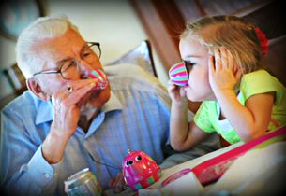
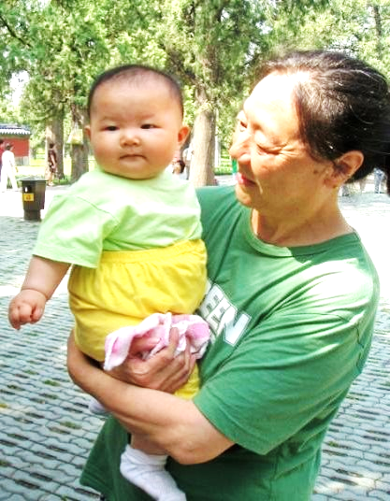

Overview of Grandfamilies supportive policies, programs and resources
Advisory Council to Support
Grandparents Raising Grandchildren
Ana Beltran, JD
Generations United
August 28, 2019

Slide 21
Generations United
Generations United’s mission is to improve the lives of children, youth, and older adults through intergenerational collaboration, public policies and programs
Since 1998, Generations United’s National Center on Grandfamilies:
  Guided by GrAND Voices – a network of caregiver advocates
  Leads an advisory group of organizations, caregivers and youth that sets the national agenda
  Provides technical assistance to states and other providers
  Raises awareness through media outreach, weekly communications and events
  Provides information and resources at www.gu.org and www.grandfamilies.org

Slide 22

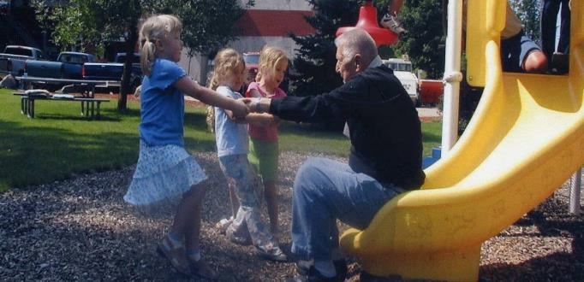
Grandfamilies
Data

Slide 23

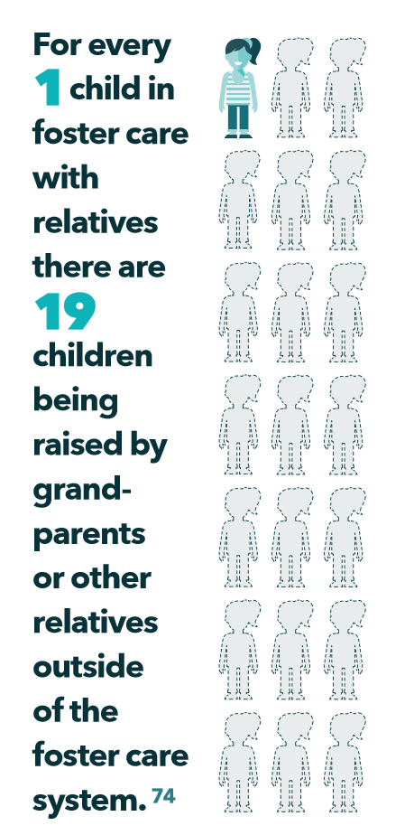
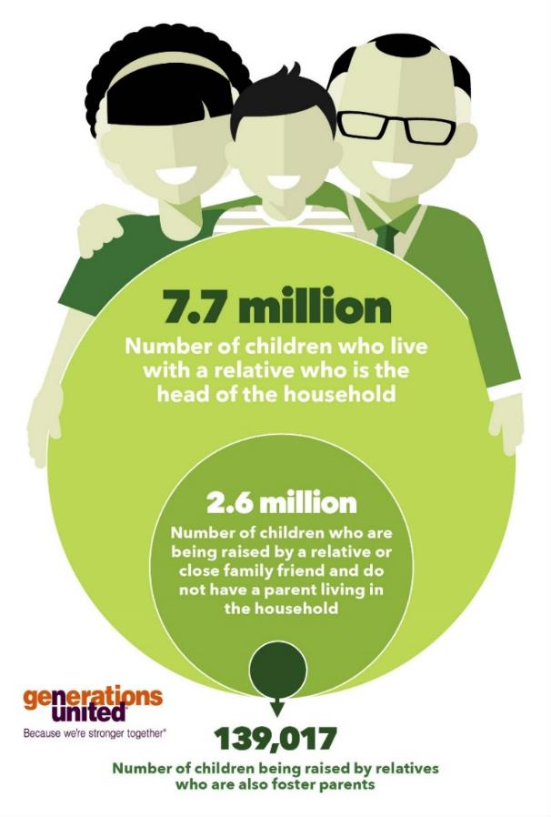
Children in Grandfamilies

Slide 24
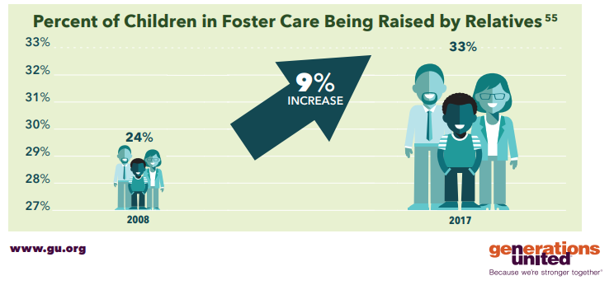
Data is not publicly available on the percentage of these children who are with licensed relatives

Slide 25
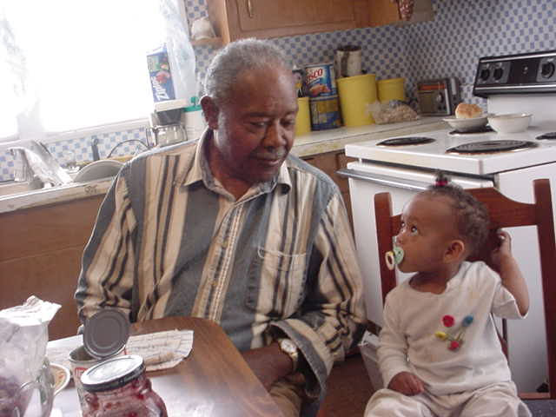
Grandparent Caregivers
2.6 million grandparents are responsible for grandchildren in the U.S.
  57% are in the workforce
  20% live below the poverty line
  25% have a disability
  40% are age 60 and over
  66% are white, 21% are black or African American, 2% are American Indian or Alaska Native, 3% are Asian and 20% are Latino
Source: S1002, Grandparents, 2013-2017 American Community Survey 5-Year Estimates

Slide 26
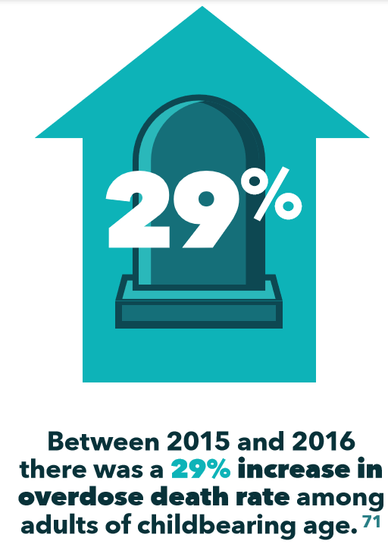
Parental Causal Factors Creating Grandfamilies
Death
Substance use
Mental health challenges
Physical and cognitive disabilities
Incarceration
Military deployment
Deportation or detainment

Slide 27
What We Don’t Know – Data Lacking
What percentage of grandfamilies are formed due to each major parental causal factor?
How many aunts, uncles, great-grandparents and other relatives are raising children?
  Workforce?
  Poverty?
  Race/ethnicity?
  And other data on these caregivers
What percentage of children in kinship foster care are with licensed relatives and what is their race and ethnicity? What is the race and ethnicity of children who are in the unlicensed care of relatives?
How many children are “diverted” from the child welfare system into the care of relatives and what is their race and ethnicity? Are these children entering foster care after unsuccessful diversion attempts?

Slide 28


Grandfamilies:
Strengths and Challenges

Slide 29
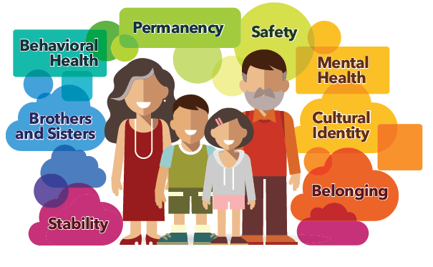
Grandfamilies Strengths: Children Thrive

Slide 30

Grandfamilies Challenges: Health
Both the caregivers and children in these families face physical and mental health issues to a greater degree than the general population:
Children exhibit a variety of physical, behavioral, and emotional challenges, often due to the difficult and traumatic situations that caused them to be placed in the relative’s care
Relative caregivers frequently suffer stress-related health problems like depression, diabetes, and hypertension, but often are unable to attend to their own health due to a lack of daycare, respite care or adequate health insurance

Slide 31

Grandfamilies Challenges: Housing
Grandfamilies often begin caring for children without warning or preparation, and face unique problems with respect to housing:
Many relative caregivers live on fixed incomes and/or in small apartments and houses that are not suitable for children
The presence of children may violate private lease agreements
If relative caregivers do not have legal custody of the children, they are often unable to convince the housing authorities to recognize their need for larger apartments

Slide 32

Grandfamilies Challenges: Education
Many school policies are geared towards “nuclear” families, and can pose obstacles for grandfamilies, especially those families outside the children welfare system and in which there are no legal ties:
Children may be denied school enrollment because their relative caregivers do not have guardianship or legal custody
Contrary to the federal law, grandparents and other relatives acting as parents may have difficulty being included as a participant in the Individual Education Plan (IEP) process for children with disabilities

Slide 33

Grandfamilies Challenges: Legal
Legal issues are frequently among the top concerns for grandfamilies, particularly for those outside the child welfare system:
The process of obtaining a legal relationship with the children – such as adoption, legal custody or guardianship -- is usually expensive, time-consuming, and can be disruptive to family dynamics
Opting to raise the children without any legal relationship may severely limit caregivers’ ability to consent to health care or access educational services on the children’s behalf

Slide 34
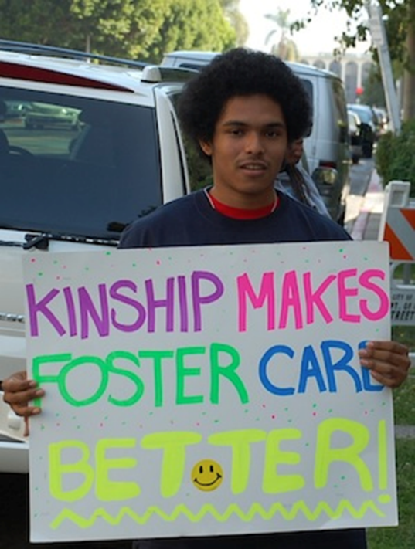
Grandfamilies Challenges:
Child welfare system
Child welfare agencies have an array of practices when it comes to relying on relatives to provide foster care, which can be inequitable:
“Divert” the children to relatives with or without supports
Do not offer the option to become licensed foster parents or discourage it
Keep the children in their legal custody, and may only “approve” relatives and not fully license them
May fully license relatives and provide a pathway to supported permanency through adoption assistance and guardianship assistance
Some agencies engage in several of these practices

Slide 35

Grandfamilies Challenges: Financial
Financial challenges are often a major struggle for grandfamilies who did not plan or expect to raise a child:
Temporary Assistance for Needy Families (TANF) child-only grants are typically the only support available to meet the needs of children raised by relative caregivers who are not licensed foster parents – TANF can be difficult to access
Because many relatives caring for children in foster care are unlicensed, they do not have access to foster care maintenance payments to meet the needs of the children

Slide 36
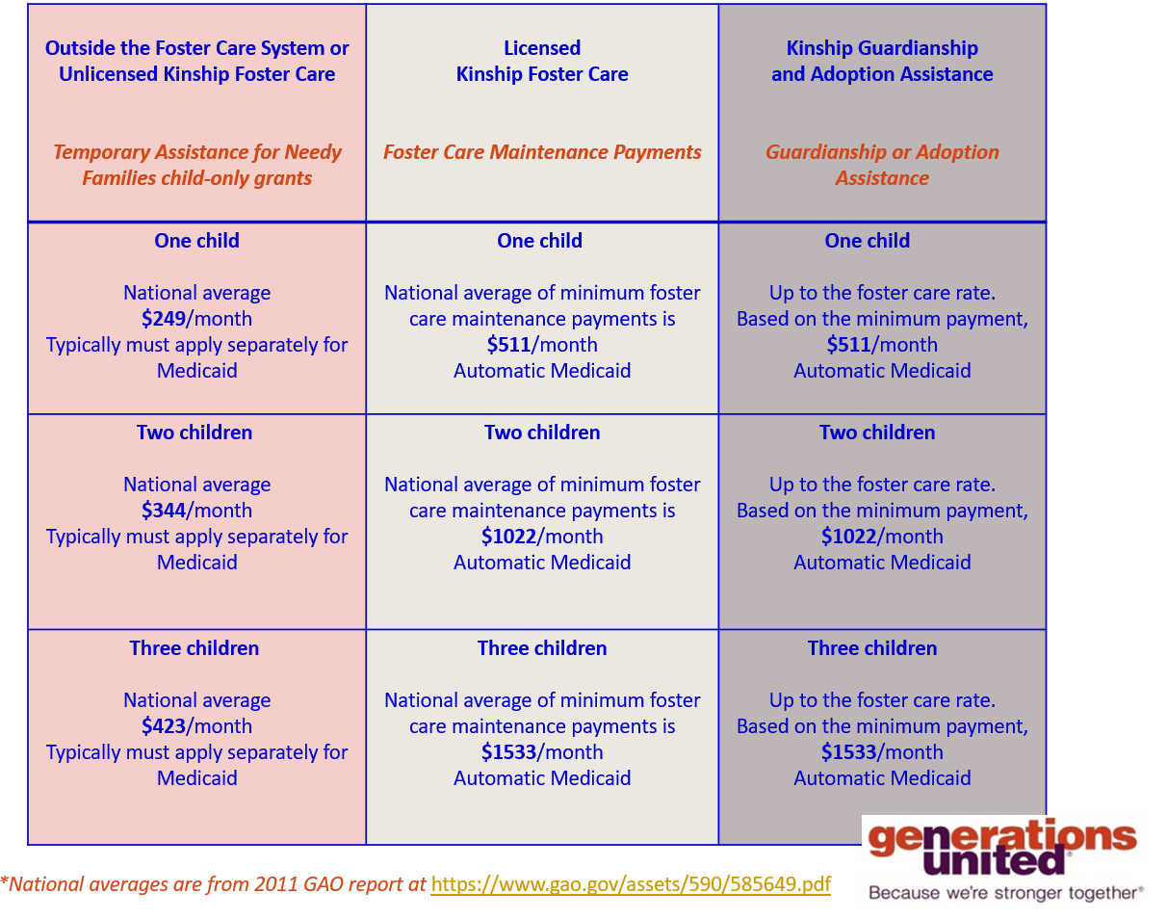
Notes:
Outside the Foster Care system Unlicensed Kinship Foster Care Temporary Assistance for need families child only grants.
One child $249 per month average typically must apply separately for Medicaid.
Two children $344 per month average typically must apply separately for Medicaid.
Three children $423 per month average typically must apply separately for Medicaid.
Licensed Kinship Foster Care, Foster Care maintenance payments
One child, average of minimum foster care maintenance payments is $511 per month automatic Medicaid.
Two children average of minimum foster care maintenance payments is $1022 per month automatic Medicaid.
Three children, average of minimum foster care maintenance payments is $1533 per month automatic Medicaid.
Header Kinship guardianship and Adoption Assistance, Guardianship or Adoption Assistance
One child up to the foster care rate, based on minimum payment is $511 per month automatic Medicaid.
Two children up to the foster care rate, based on minimum payment $1022 per month automatic Medicaid.
Three children, up to the foster care rate, based on minimum payment is $1533 per month automatic Medicaid.

Slide 37

Policy and
Program
Responses

Slide 38
Policy and Program Responses:
Grandfamilies who are child welfare system involved
Federal Law Funds Services to Prevent Children From Needing to Enter Foster Care:
  The Family First Prevention Services Act (Family First) provides the option to use federal funds for mental health, substance use, and in-home parent (caregiver) skills training for children who are at imminent risk of foster care entry, along with their kinship caregivers and parents
If Children Enter, Federal Law Prefers Relative Placement and Encourages Their Engagement:
  Placements with relatives expressly preferred
  Must identify and notify relatives when a child is removed from their parents’ home
  Cannot have a two-tiered system of licensing relatives and non-relatives, but non-safety related licensing standards can be waived for relatives
  Federal law seeks to break down barriers to licensing relatives through Family First Act and National Model licensing standards
  Relatives must receive the same foster care maintenance payment rate as non-relatives if they are licensed
  If relatives are licensed, children may be able to exit foster care into subsidized guardianships with their relative caregivers - Guardianship Assistance Programs (GAP)

Slide 39
Policy and Program Responses:
Grandfamilies outside the child welfare system
State created legal relationships, including educational and health care consent laws allow caregivers without legal custody of the children to access health care and educational services on their behalf
TANF (Temporary Assistance for Needy Families) reforms:
  Enhanced TANF programs, such as Louisiana’s Care Subsidy Program
  Streamlined applications
  Use of good-cause exemption to assigning child support
  For more information, see Improving Grandfamilies’ Access to TANF
  (see URLs in slide notes.)
Notes:
educational and health care consent laws: http://www.grandfamilies.org/Portals/0/documents/GU Policy Brief October 2014.pdf
Louisiana’s Care Subsidy Program: http://www.dss.state.la.us/index.cfm?md=pagebuilder&tmp=home&pid=138
Improving Grandfamilies’ Access to TANF: http://www.grandfamilies.org/Portals/0/Documents/2

Slide 40
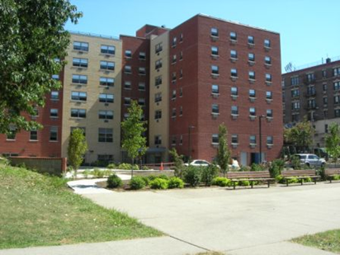
Program and Policy Responses:
All grandfamilies
Kinship Navigator Programs
  Family First Act authorizes ongoing federal reimbursement
  2018 & 2019 funds to states, tribes, and territories to develop, enhance, or evaluate these programs
National Family Caregiver Support Program federally funds Area Agencies on Aging (AAAs) to provide 5 categories of supportive services to grandfamilies
Affordable grandfamilies housing with services on-site exist in various communities around the country
Supporting Grandparents Raising Grandchildren Act creates federal advisory council!
GrandParent Family Apartments in South Bronx, NY

Slide 41
More to Do…
Many wonderful policy and program responses, but work remains to be done:
  Remaining jurisdictions take GAP option and fully implement it
  Additional states enact flexible legal relationship options – like educational and health care consent laws – and implement TANF reforms that allow greater access
  A national grandfamilies technical assistance center is established to, among other things, serve as a national kinship navigator that coordinates state and tribal kinship navigator programs
  Lessons learned from AAAs that provide supportive services to relative caregivers are shared and more AAAs serve these caregivers
  A toolkit is developed so that more supportive grandfamilies housing can be built

Slide 42

Selected National Resources

Slide 43
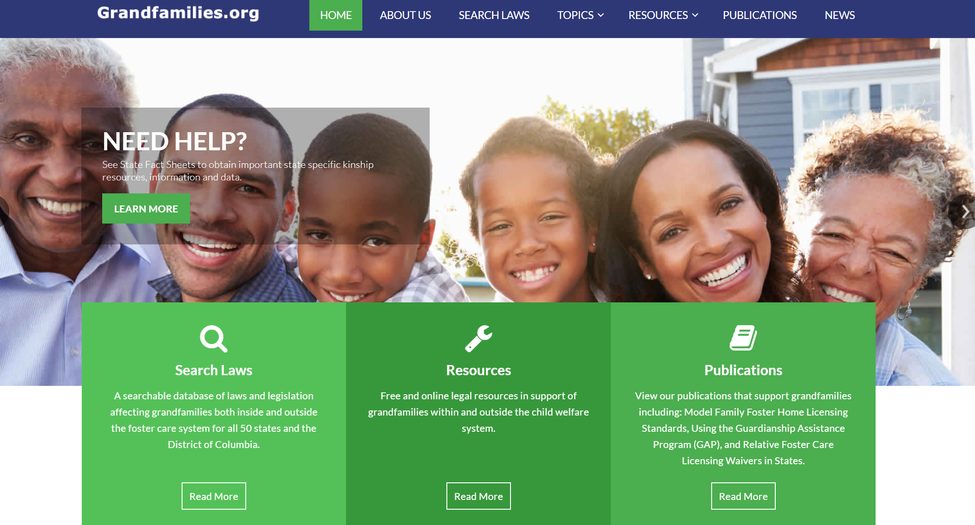
A collaboration of the
ABA Center on Children and the Law,
Generations United and Casey Family Programs

Slide 44

State of Grandfamilies Report - Opioid Epidemic
Because of the opioid epidemic, the number of children in foster care is increasing after years of decline
Children placed in family foster care because of a parental drug or alcohol use are now more likely to be placed with relatives than non-relatives

Slide 45

Tips, practical information and resources to help grandfamilies inside and outside the child welfare system impacted by opioids or other substance use.
Topics include:
-Practicing Self-Care
-Addressing Childhood Trauma
-Preventing Harmful Drug Use by Children
-Engaging with Birth Parents
-Talking with a Child about their Birth Parent
Available at: www.grandfamilies.org/Portals/0/Documents/Grandfamilies-Report-GRANDResource-Opioids.pdf

Slide 46

Chart includes:
-Rights and Responsibilities
-Financial and Legal Assistance
-Public Benefits
-Health Insurance
-Federal and State Tax Credits
-Caregiver Successor Planning and Death Benefits for Children
-College and Independent Living
Available at: www.grandfamilies.org/Portals/0/Documents/2017/Grandfamilies-Adoption-Guardianship-Chart-Final%20%282%29.pdf

Slide 47
State Fact Sheets
All 50 States and District of Columbia
Available at www.grandfamilies.org

Slide 48
Additional Grandfamilies Resources*
American Bar Association
Center on Children and the Law
www.americanbar.org/groups/child_law.html
Annie E. Casey Foundation
www.aecf.org
The Brookdale Foundation Group –
Relatives As Parents Program (RAPP)
www.brookdalefoundation.org
Casey Family Programs
www.casey.org
Child Welfare League of America (CWLA)
www.cwla.org
Children’s Defense Fund
www.childrensdefense.org
Grandfamilies: The Contemporary Journal of Research, Practice and Policy
https://scholarworks.wmich.edu/grandfamilies/about.html
Grantmakers in Aging
www.giaging.org/issues/grandfamilies/
*There are many other excellent national groups who strive to support grandfamilies, and this list is not exhaustive.

Slide 49

COMING SOON
State of Grandfamilies 2019
November 14 release
Focus on Housing

Slide 50

Generations United
Contact Information
Ana Beltran
abeltran@gu.org
Jaia Peterson Lent
jlent@gu.org

Slide 51
Family Dynamics and the Impact of Kinship Care
Dr. Joseph Crumbley, LCSW www.drcrumbley.com

Slide 52
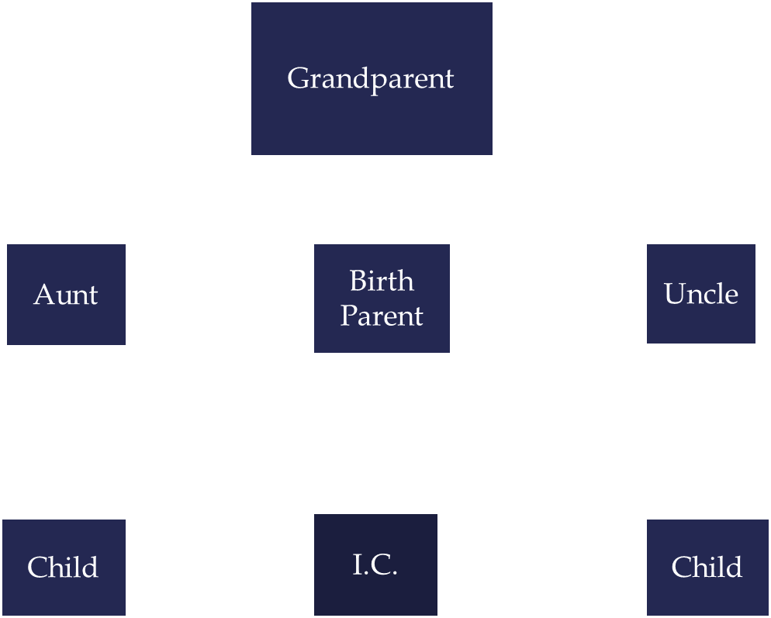
Genogram of Kinship Family
Notes:
Grandparents
Aunt
Child
Birth Parent
I.C.
Uncle
Child

Slide 53
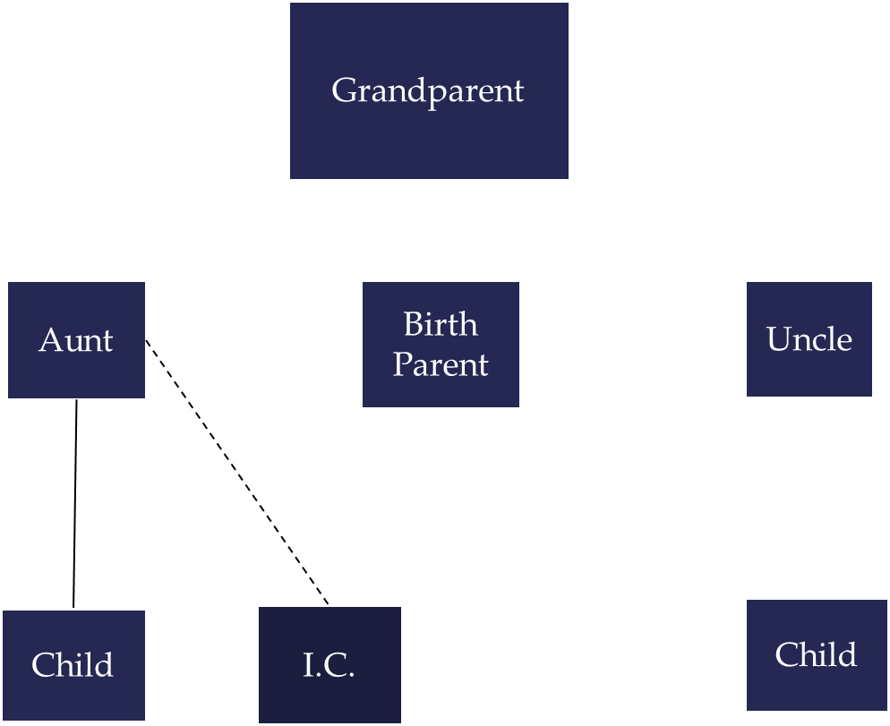
Genogram of Kinship Family Changes
Notes:
Grandparents
Aunt
Child
I.C.
Birth Parent
Uncle
Child

Slide 54
How Kinship Care
Changes Family Dynamics Pre-Exisiting
Placing Children in Kinship Care changes PRE-EXISTING:
Relationships
Responsibilities
Roles
Accountability
Power
Status
Authority
Loyalties
Notes:
Speaking to Audience
Call and Response (responses will be repeated by speaker)

Slide 55
How Kinship Care
Changes Family Dynamics
Family Members often assume they have the same
Rights, Entitlements and Privileges
they had PRIOR TO the child’s placement

Slide 56
Mapping Changes in
Family Dynamics Can Identify:
Re-alignments
Resistance
Sabotage
Collusion
Where buy-in is needed
Losses
Notes:
Speaking to Audience

Slide 57
Module # 4
LOYALTY

Slide 58
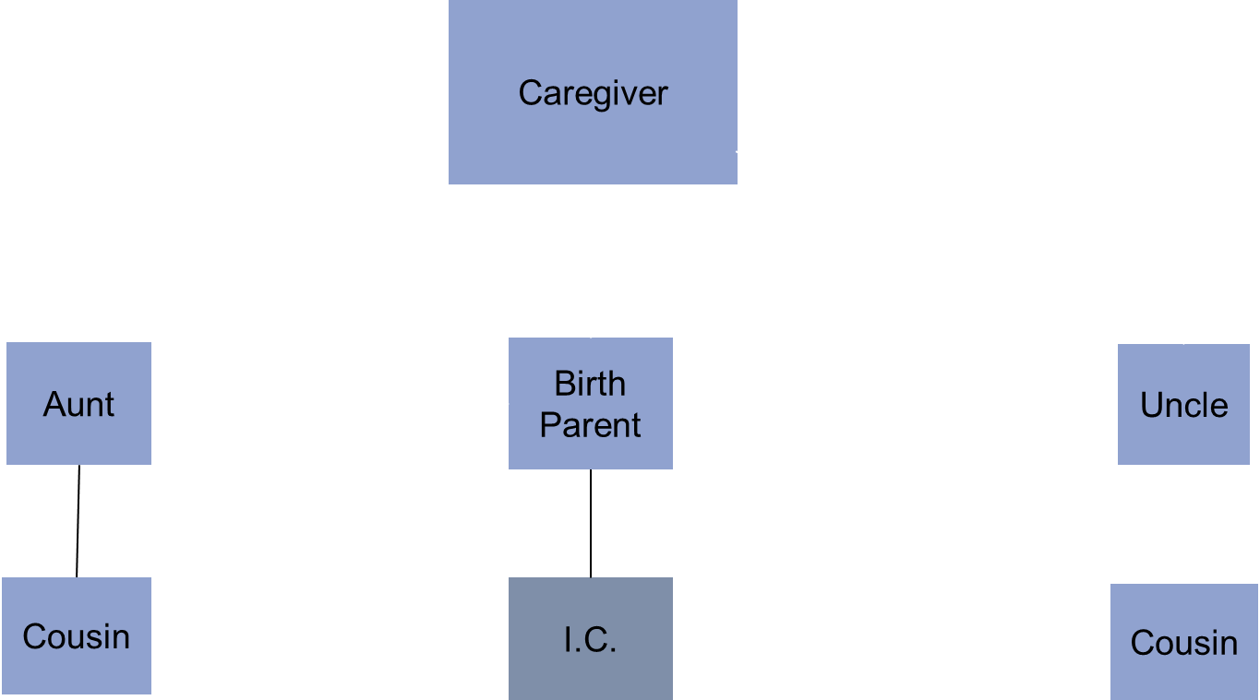
Genogram of Shifting Loyalties
Notes:
Grandparents – agencies and authorities involved
Aunt
Cousin
Birth Parent
I.C.
Uncle
Cousin

Slide 59

Genogram of Shifting Loyalties
Notes:
Grandparents – agencies and authorities involved
Aunt
Cousin
Birth Parent
I.C.
Uncle
Cousin

Slide 60
Facilitated Discussion
What are key opportunities for the Grandparent Act to support grandfamilies?
How are the needs of grandparents influenced by differing experiences in the role?
How does the age, gender, ethnicity, socioeconomic status, employment, physical and mental health, and other attributes of the grandparent affect their experience and support needs?
What types of information, resources and best practices are of most benefit to grandparents and older relatives in meeting their caregiving responsibilities?

Slide 61
On a Break we will return shortly

Slide 62
Public Comment Period
If you are watching the livestream and wish to provide input:
Phone Number: 888-469-1678
Passcode: 3957543

Slide 63
Re-Capping Day 1
Thoughts or questions about today?
Tomorrow, August 29, 2019
  Federal Programs & Initiatives: Discussion
  Sub-committee roles
  Small group priority setting exercise
  Small group report-outs
  Public Comment
  Re-cap and next steps/adjourn

Slide 64
Advisory Council to Support Grandparents Raising Grandchildren Meeting
Washington, DC
August 28-29, 2019
Day 2
Notes:
Page numbers are intentionally omitted from this title slide. An alternate title slide design is shown as Slide 2 in this template deck. Use only one or the other.

Slide 65
Review Day 1/Overview Day 2
Questions or thoughts about yesterday?
Today’s Agenda
  Overview: Federal Programs & Initiatives
  Small Group Priority Setting Exercise
  Sub-committee formation
  Small Group Report-Outs
  Public comment
  Next Steps & adjourn

Slide 66
Federal programs & Initiatives in Support of Grandparents

Slide 67
Federal Programs & Initiatives Supporting Grandparents
Questions for our Federal Partners:
What programs/initiatives does your agency currently have that are designed:
  To assist grandparents raising younger family members (e.g., nutrition, legal, education, financial, emotional support/well-being)?
  To provide services and programs for children (e.g., nutrition, education, emotional support/well-being) being raised by grandparents?
Can you speak to some of the gaps, and possible ways to address the gaps, you see in the current programs/services?
What takeaways do you want the Council to know about your agency and its programs to support grandfamilies

Slide 68
Federal Programs & Initiatives Supporting Grandparents-Questions
Questions for all Council members:
What are some current sources of best practices we should be considering for the report?
What gaps do you see in current programs? How should they be addressed?
Which programs are most utilized (or not) and why?
What takeaways do you want the Council to consider to better support grandfamilies.

Slide 69
On a Break we will return shortly

Slide 70
Discussion: Subcommittee topics & priority setting

Slide 71
Information Gathering
Requests for Information (RFI)
Environmental Scans
Literature Reviews
Others?
Question: What are the existing sources of information regarding resources and best practices for supporting grandparents that we need to know about?
Notes:
One of the key activities of the Grandparent Act is the gathering of information and best practices on a range of topics and then disseminating that information so it can be put to use to improve services and supports for grandparents and older relatives.
We (the Council and ACL) have at our disposal a number of methods for obtaining the information from the public.
However, we think it is important to first get a handle on what is already known. In that regard, we should start with what is known already about best practices in the areas the Act requires and then figure out the gaps that exist or the updates to that information that are needed before going out with an RFI gathering new info.

Slide 72
Subcommittee Roles & Responsibilities
During this initial meeting, we will form up to four subcommittees
Each subcommittee will meet monthly and consist of Council, Federal, and Stakeholder members
Subcommittees can:
  Review and prioritize materials submitted for inclusion in the report
  Contribute to the writing of the initial and follow-up reports
  Engage in planned dissemination activities
Members can serve on more than one subcommittee
Subcommittees may engage outside stakeholders and other experts – keep ACL informed

Slide 73
Possible Sub-Committee Topics
Physical & Emotional Health and Wellbeing
Policy
Economic Security
Education
Services and Support
Research
Nutrition
Legal
Other???

Slide 74
Small Working Group
Exercise we will return shortly

Slide 75
Small group report outs &
Priority Setting

Slide 76
Public Comment Period
If you are watching the livestream and wish to provide input:
Phone Number: 888-469-1678
Passcode: 3957543

Slide 77
Day 2 Wrap-up
Final thoughts?
Next Steps
Adjourn

Slide 78
Contact Us
Comments? Input? Questions?
Just want to share information relevant to the work of the Advisory Council to Support Grandparents Raising Grandchildren?
Email us at: SGRG.Act@acl.hhs.gov

Slide 79
Thank you!
Notes:
The ACL logo shown here is part of the master, as it is assumed that an initial instance of the logo will appear on the title slide with appropriate alt. text that does not need to be re-read here by assistive technology. If this is the only place where the ACL logo will appear, remove it from the slide master and insert it with alt. text.

